Slide 1
LICENSE PLATE IDENTIFICATION
Name : Nguyễn Khoa Nguyên
Class : Tonga
School : coder school 03-06/2020

Slide 2

How can i do it ?
My idea :
The first : i must have image have a license plate
The second : i crop the license plate from image
The third : i convert the text from the license plate image

Slide 3
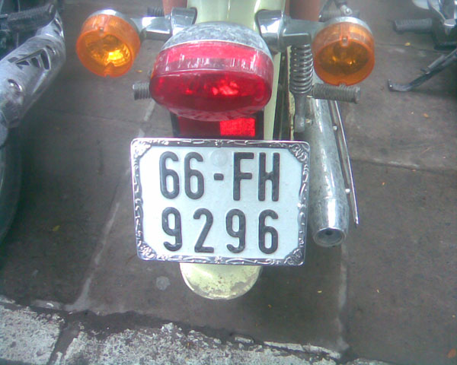
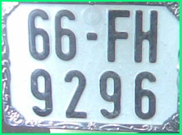
66–FH 9296

Slide 4
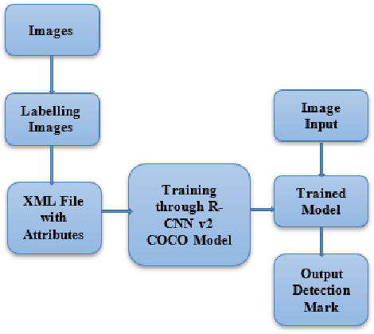
My plan for i do PROJECT
Get data
Set up environment for training
Training model with data i chose
detection image

Slide 5
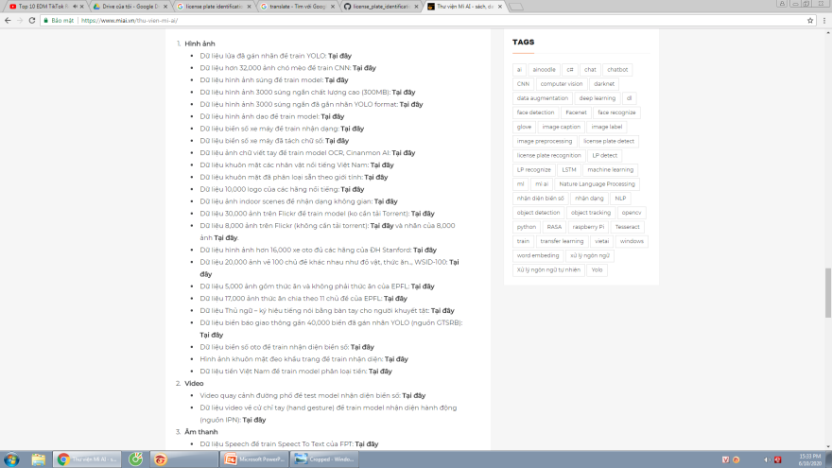
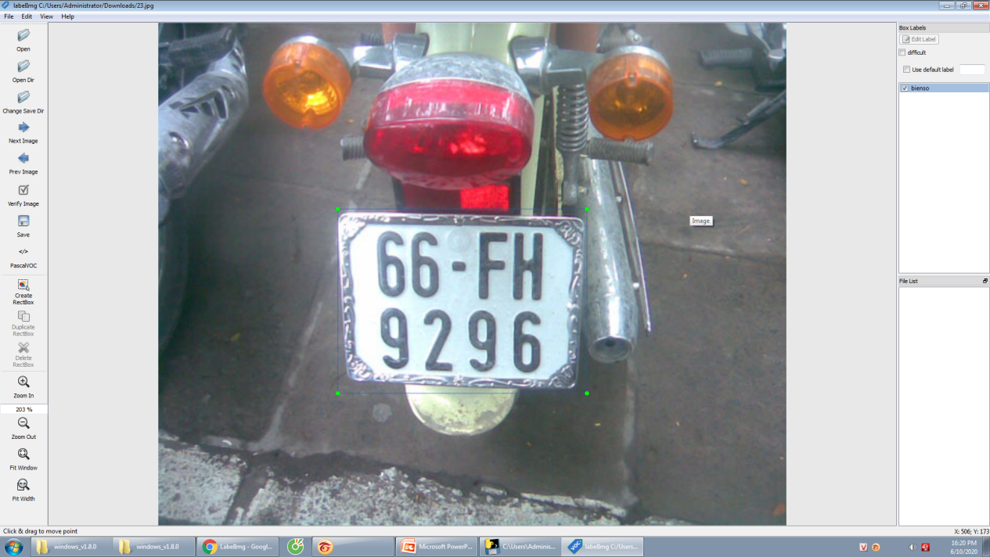
First step : get data and label data for train
Get data from :
https://www.miai.vn/thu-vien-mi-ai/
Unrar and divide to 2 part train and test forder : 8 : 2
And label image both forder train and test

Slide 6




Second step : set up environment
Download anaconda3 from : https://repo.anaconda.com/archive/ (version 03/2019)
Install some library for environment for train :

Slide 7
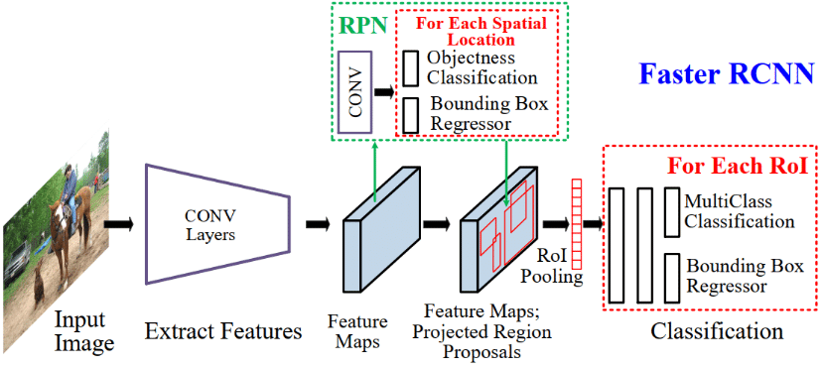
Third step : Training data
I use the faster_RCNN_inception_v2

Slide 8
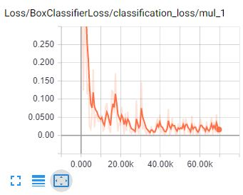
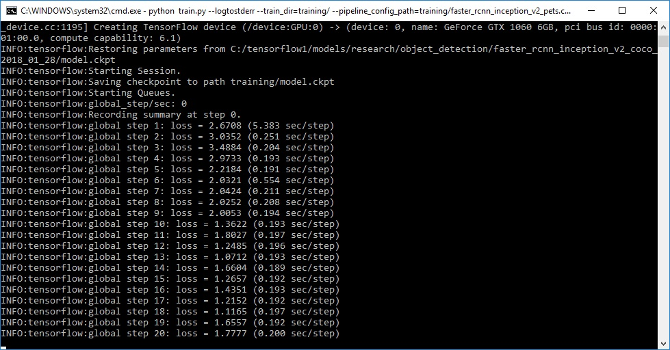
Third step : Training data
I run about 350 step when the loss ~ 0.05

Slide 9
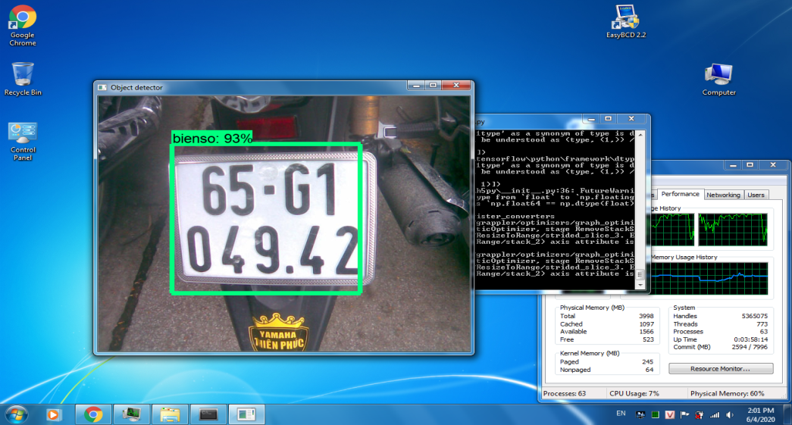
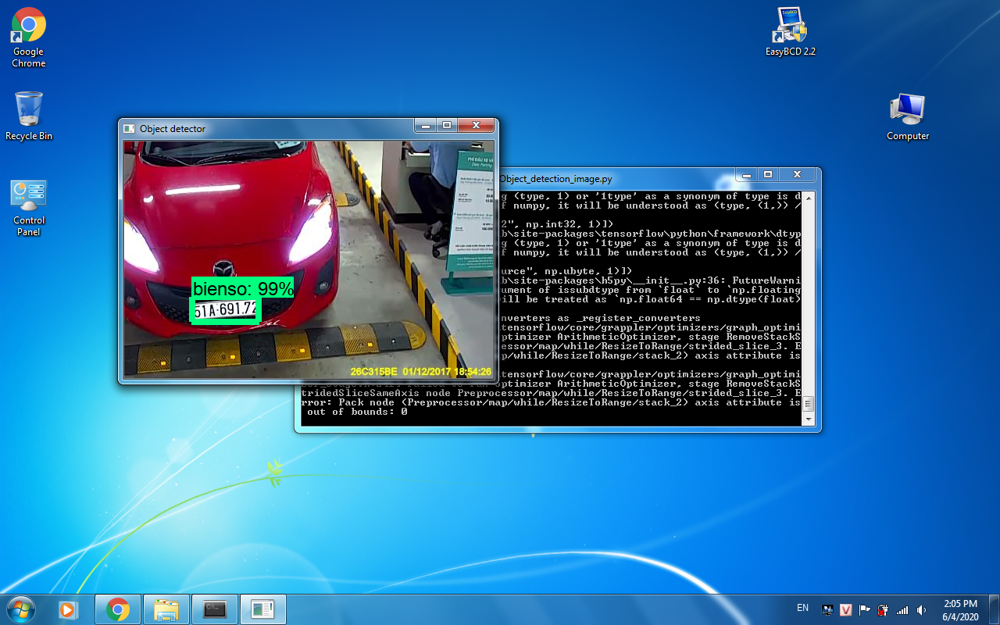
Fourth step : detection Image
I test some picture : get location the license plate in the picture

Slide 10
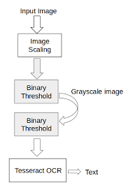
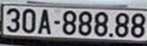
Fourth step : detection image
I crop the license plate
load with Library Tesseract OCR to Get text :
30A – 888.88

Slide 11
Future for ProJECT
Upgrade new technology for model
Increase the accuracy and faster for model (reduce the size of model)
Build the Practical app

Slide 12
References
https://www.google.com/
https://github.com/Tdpro1612/license_plate_identification/tree/master/models/research/object_detection
https://www.miai.vn/2019/11/26/nhan-dien-bien-so-xe-chuong-3-phat-hien-bien-so-bang-opencv-thuan/
https://www.youtube.com/watch?v=K_QIQ3ujssk

Slide 13
Example Flask app

Slide 14


